Slide 1
10
Chapter
Motivating
and Rewarding Employees

Slide 2
What is Motivation?
The process by which a person’s efforts are energized, directed, and sustained toward attaining a goal; 3 key elements
  Energy - a measure of intensity or drive. A motivated person puts forth effort and works hard.
  Direction - the quality of the effort must be considered as well as its intensity; effort is channeled to benefit the organization
  Persistence – it is desired employees persist in putting forth effort to achieve the goals
  Overall motivation varies from situation to situation
  Individuals differ in motivational drive; personal trait

Slide 3
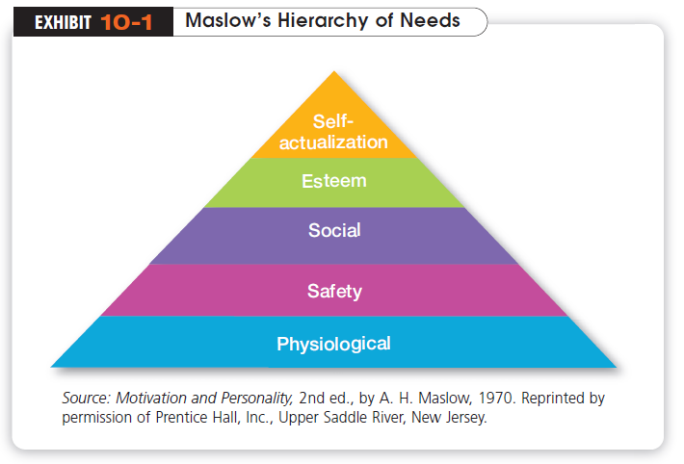
Maslow’s Hierarchy of Needs Theory
The best-known motivation theory was put forward by a psychologist who proposed that within every person is a hierarchy of five needs:

Slide 4

Maslow’s need theory has received wide recognition, especially among practicing managers.
Its popularity probably can be attributed to the theory’s intuitive logic and ease of understanding.
But Maslow provided no empirical support for his theory, and several later studies could not validate it.

Slide 5
Theory X and Theory Y
McGregor is best known for proposing two assumptions about human nature:
Theory X
  The assumption that employees dislike work, are lazy, avoid responsibility, need to be closely controlled to work effectively and must be coerced.
Theory Y
  The assumption that employees are creative, enjoy work, seek responsibility, and can exercise self-direction.
No hard evidence confirm either of the set of assumptions is valid or being Y Manager is superior way of motivating.

Slide 6
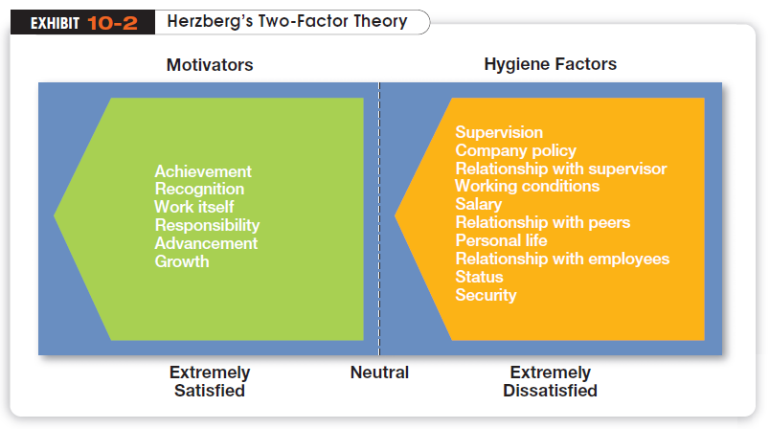
Herzberg’s Two-Factor Theory
Motivation-hygiene theory proposes that:

Slide 7
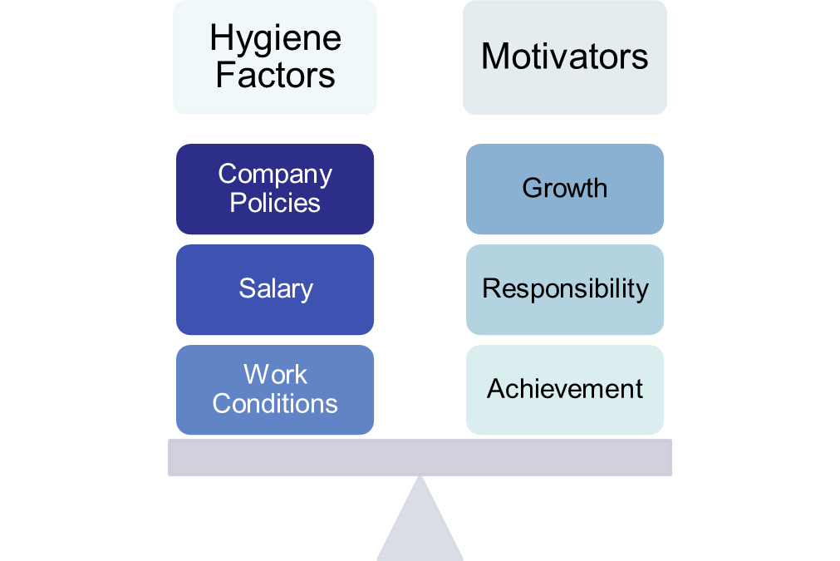
Herzberg’s Two-Factor Theory
Intrinsic and Related to Satisfaction
Extrinsic and Related to Dissatisfaction

Slide 8
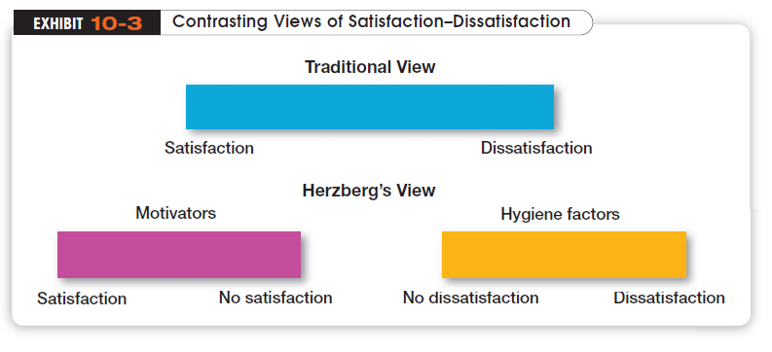
Key Point: Satisfaction and dissatisfaction are not opposites but separate constructs.

Slide 9
Hygiene Factors: Factors that eliminate job dissatisfaction but don’t motivate.
  Extrinsic factors are associated with job dissatisfaction
Motivators: Factors that increase job satisfaction and motivation
  Intrinsic factors are related to job satisfaction
Herzberg’s theory enjoyed wide popularity from the mid-1960s to the early 1980s, despite criticisms of his procedures and methodology. It has influenced how we currently design jobs.

Slide 10
McClelland’s Three-Needs Theory
  Three acquired (not innate) needs are major motives at work
Need for Power (nPow)
  The need to make others behave in a way that they would not have behaved otherwise
Need for Affiliation (nAff)
  The desire for friendly and close interpersonal relationships
Need for Achievement (nAch)
  The drive to succeed and excel in relation to a set of standards; the need that has been researched the most.

Slide 11
Performance Predictions
People with a high need for achievement are likely to:
  Prefer to undertake activities with a 50/50 chance of success, avoiding very low- (easy) or high-risk (very difficult) situations
  Be motivated in jobs that offer high degree of personal responsibility, feedback, rather than rewards of success.
  Not necessarily make good managers – too personal a focus.
  Best managers tends to have high level of nPow and low nAff
  They perform high when they can impact many people
Good research support, but not a very practical theory. People have varying levels of each of the three needs and it is hard to measure.

Slide 12
Goal-Setting Theory
Specific goals increase performance
Difficult goals, when accepted, result in higher performance
There is substantial research support in individualistic societies for the theory.
  Three contingencies influence the goal-performance relationship
Goal Commitment
Belief in Self-Efficacy
  National Culture assumes that subordinates will be reasonably independent (low power distance), people seek challenging goals (low uncertainty avoidance), and that performance is considered important by both managers and subordinates (high assertiveness).

Slide 13
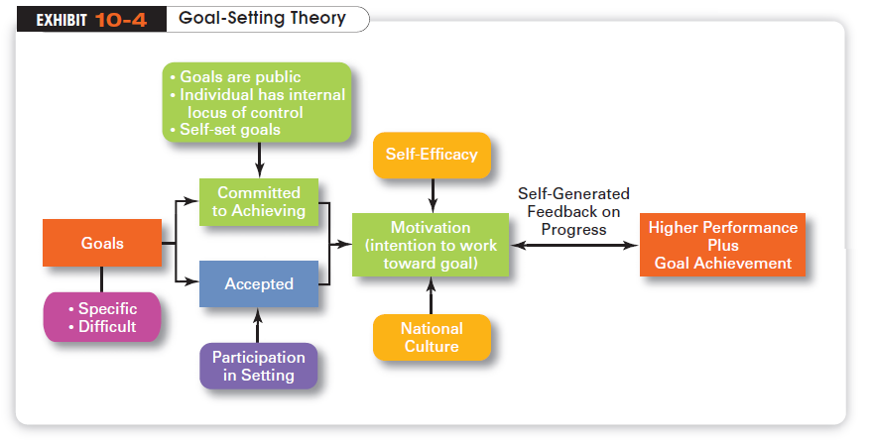

Slide 14
How Does Job Design Influence Motivation?
The term Job Design refer to the way tasks are combined to form complete jobs.
Job Characteristics Model (JCM)
  A framework for analyzing and designing jobs that identifies five primary core job dimensions, their interrelationships, and their impact on outcomes
  The JCM provides significant guidance to managers for job design for both individuals and teams.

Slide 15
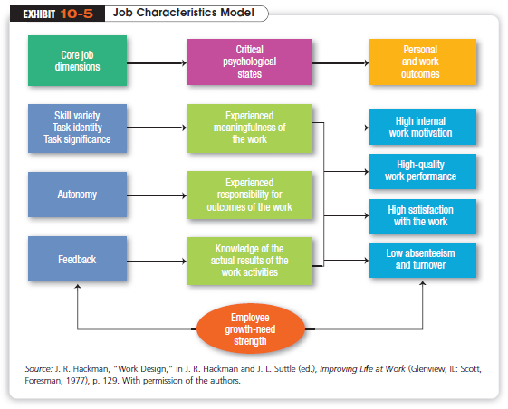
Copyright ©2011 Pearson Education

Slide 16
Job Redesign to Motivate
1. Job Rotation
When the job is composed of repetitive tasks, tasks with little variety, little autonomy and challenge.
2. Job Enlargement
Increasing the number and variety of tasks to increase diversity horizontally. In other words, adding new responsibilities to increase skill variety and task identity. Often met with limited enthusiasm.
Ex. Wait-staff in a restaurant: Takes reservations + Seats the guests + Coat-check
3. Job Enrichment
The vertical expansion of a job by adding independence, planning and evaluation responsibilities; motivates only those with high growth need.
Often reduces absenteeism and turnover costs, increase satisfaction
Real life example:
  Bank clerks processing import/export files in an assembly line fashion → boredom, low satisfaction
  After 200 hours of finance and law training
  Full-service advisers who process individual transactions
  Productivity tripled, satisfaction, transaction volume increased 10%

Slide 17

Equity Theory
  The theory proposes that an employee compares his or her job’s input-outcomes ratio with that of relevant others and then corrects any inequity
  Referent: The persons, systems, or selves against which individuals compare themselves to assess equity

Slide 18
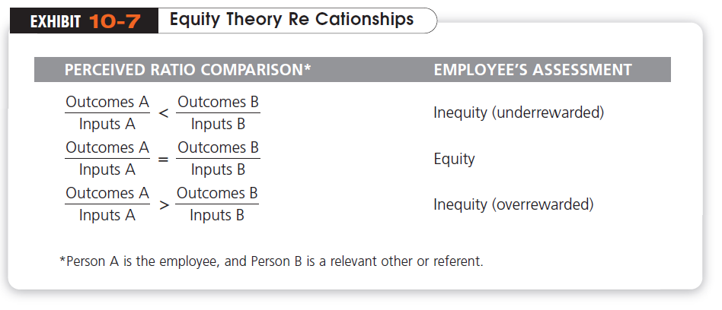

Slide 19
Equity Theory (cont.)
Originally, equity theory focused only on allocation of rewards, or Distributive Justice
  Perceived fairness of the amount and allocation of rewards among individuals
More recent research has focused on looking at issues of Procedural Justice
  Perceived fairness of the process used to determine the distribution of rewards
  Requires open and consistent information sharing on how allocation decisions are made.

Slide 20
The Expectancy Theory’s Explanation of Motivation
The most comprehensive explanation of how employees are motivated is Victor Vroom’s theory. Although the theory has its critics, most research evidence supports it.
  An individual tends to act in a certain way, based on:
  the expectation that the act will be followed by a given outcome
  the attractiveness of the outcome to the individual

Slide 21
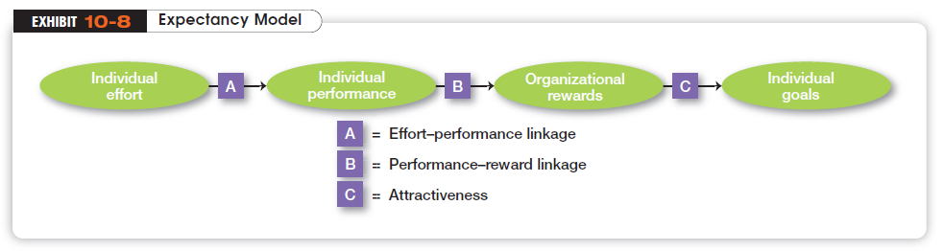
1. Expectancy or effort-performance linkage is the probability perceived by the individual that exerting a given amount of effort will lead to a certain level of performance.
2. Instrumentality or performance-reward linkage is the degree to which the individual believes that performing at a particular level is instrumental in attaining the desired outcome.
3. Valence or attractiveness of reward is the importance that the individual places on the potential outcome or reward that can be achieved on the job. Valence considers both the goals and needs of the individual.

Slide 22
Expectancy theory helps explain why a lot of workers merely do the minimum necessary to get by.
For example: If I give a maximum effort, will it be recognized in my performance appraisal?
  No, if the organization’s performance appraisal assesses nonperformance factors. The employee, rightly or wrongly, perceives that his/her boss does not like him/her.
If I get a good performance appraisal, will it lead to organizational rewards?
  Typically many employees see the performance-reward relationship in their job as weak (seniority, being cooperative, “kissing up” the boss).
If I am rewarded, are the rewards ones that I find personally attractive?
  It is important that the rewards be tailored to individual employee needs.
The key to expectancy theory is the understanding of an individual’s goals and the linkage between effort and performance, between performance and rewards, and finally, between the rewards and individual goal satisfaction.
As a contingency model, expectancy theory recognizes that there is no universal principle for explaining everyone’s motivations.
But attempts to validate the theory have been complicated by methodological criteria and measurement problems.

Slide 23
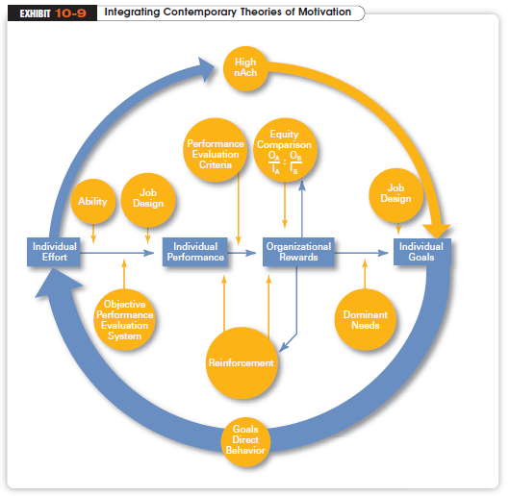
Notes:
Many of the ideas underlying the contemporary motivation theories are complementary, and you’ll understand better how to motivate people if you see how the theories fit together. Exhibit 10-9 presents a model that integrates much of what we know about motivation. Its basic foundation is the expectancy model.

